Slide 1
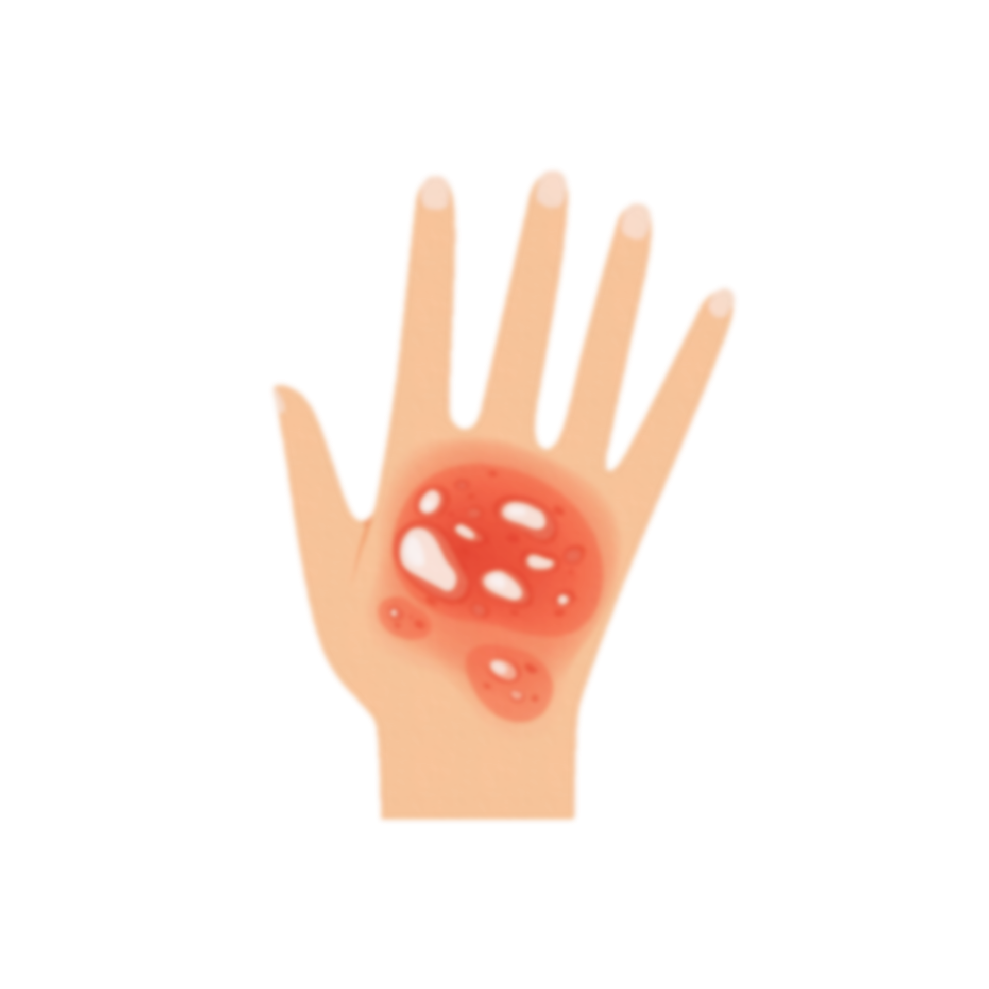
SKIN BURN
DETECTION
Made by : Madhur Nagrath, Praanjjal Aggnihotri

Slide 2
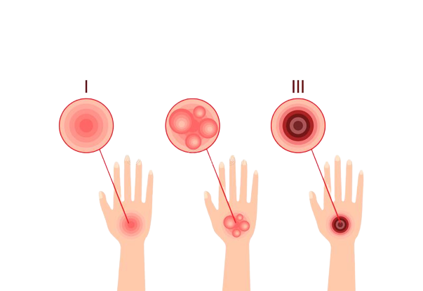
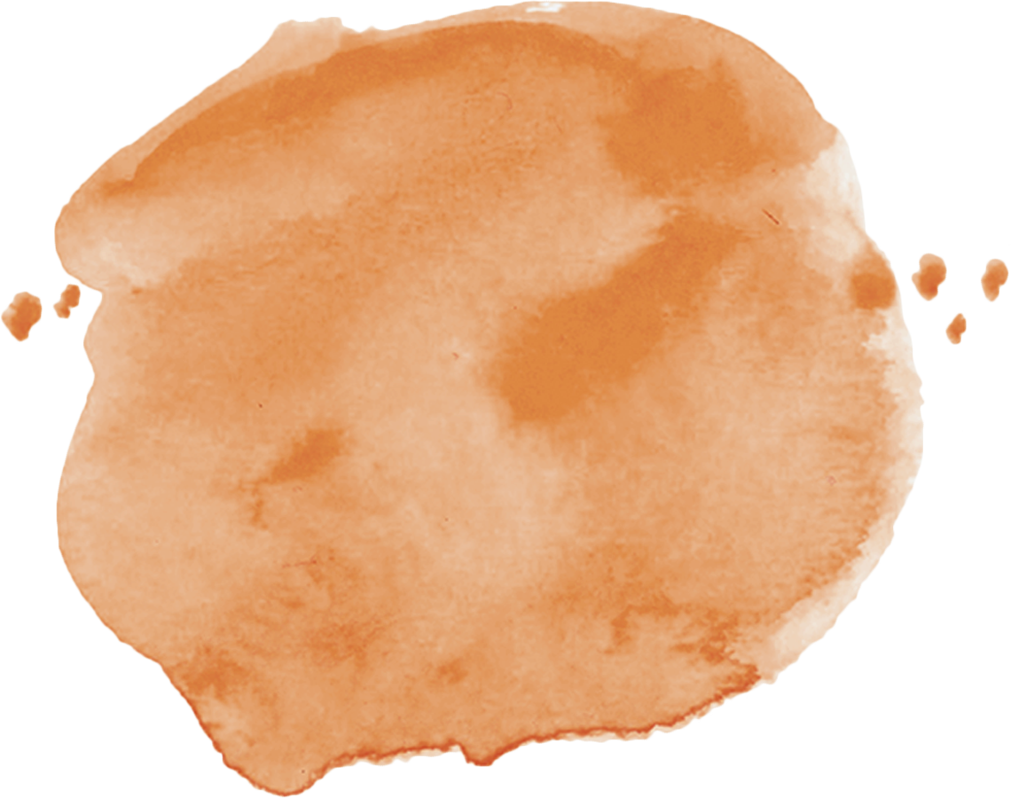
Problem Statement
Skin Burn is a vital problem which is often ignored, this is due to the unawareness regarding the detection of different degrees of skin burn.
Our project aims to help identify the different degrees of skin burn based on the image given to it
This can be useful to first responders
Doctors/Nurses
For automation

Slide 3
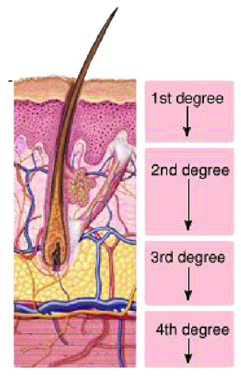
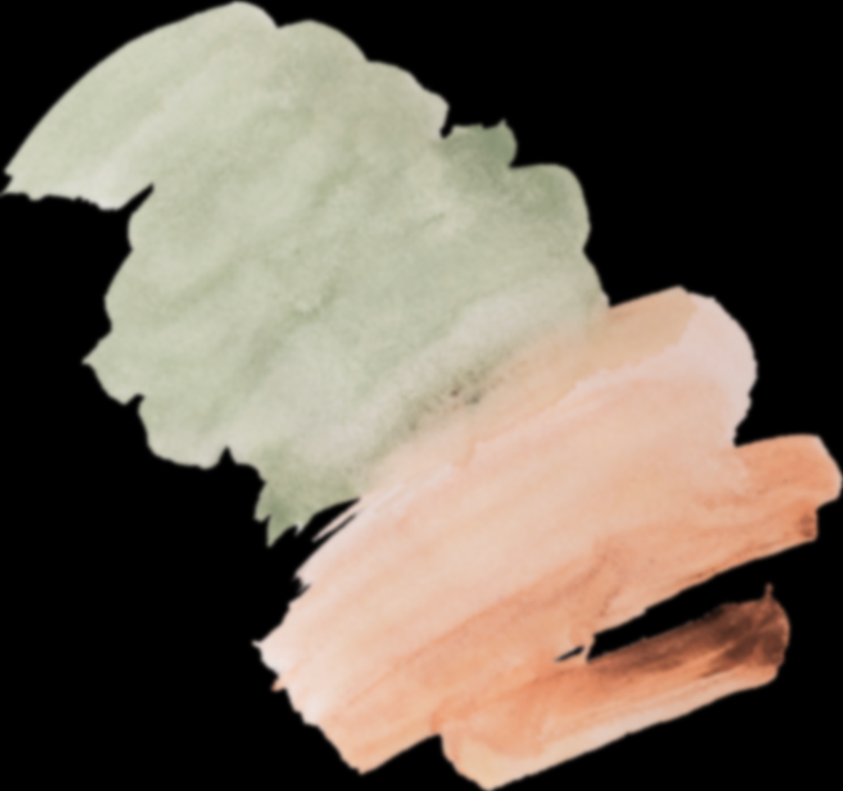
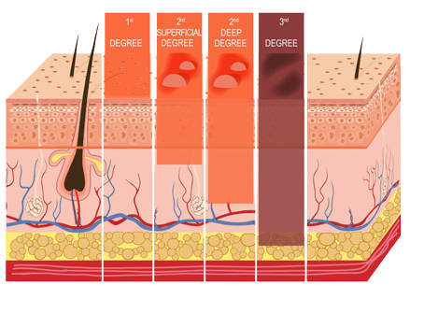
A medical expert with clinical experience is necessary to have, to conduct examination at emergency rooms in hospitals or in clinics.
Burn area, depth, and location are the critical factors in determining the degree of burns.
A patient may have a burn where there’s no specialized facility available, in such a case a computerized automatic burn assessment tool may aid diagnosis.
How are Burns Identified?

Slide 4

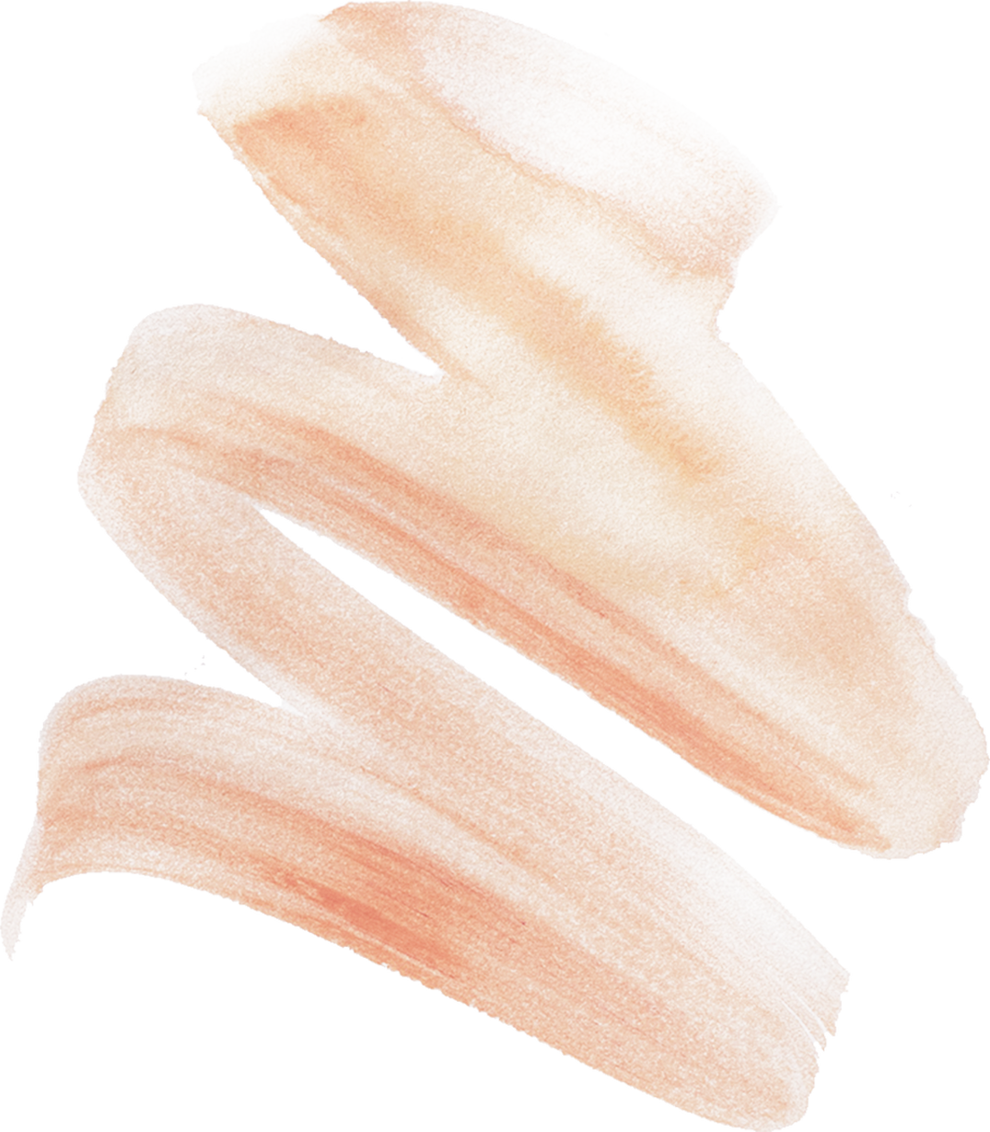
It’s a clinical diagnosis, i.e. made based on observation & reported symptoms
It is hard to differentiate between a degree 2 & degree 3 burn
Clinical Diagnosis of burns usually takes anywhere between 48 hrs. – 72 hrs.
A burn may naturally progress from 2nd degree to 3rd degree burn over this period of time.
Our Objective is to provide faster & improve the overall diagnosis of skin burns.
Objective

Slide 5
Models Applied
01
02
03
04
BASIC CNN
RESNET
50
VGG
19
INCEPTION
NET
Accuracy: 66.7%
Validation Loss: 63.6%
Accuracy: 71.6%
Validation Loss: 75%
Accuracy: 96.3%
Validation Loss: 13.1%
Accuracy: 94.8%
Validation Loss: 31.6%

Slide 6
Issues
With the current project
Accuracy measured is inaccurate to the real possible accuracy
Major portion of training data was used during testing
Dataset is small, about a 1k image samples
Need to perform data collection, need of labelled data
Scraping of images for every body part
Model is extremely inefficient
Only works on burns located on the skin
No proper Data processing was done
Can use image segmentation/object detection to improve results

Slide 7
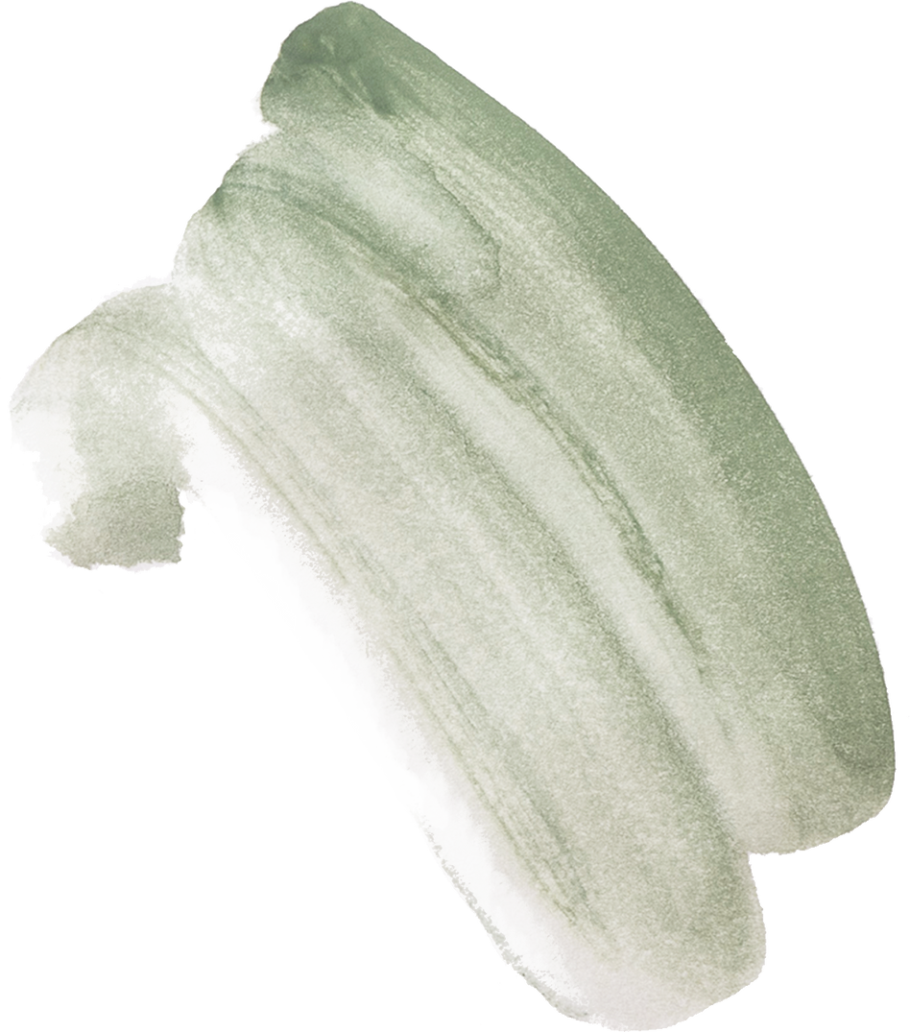
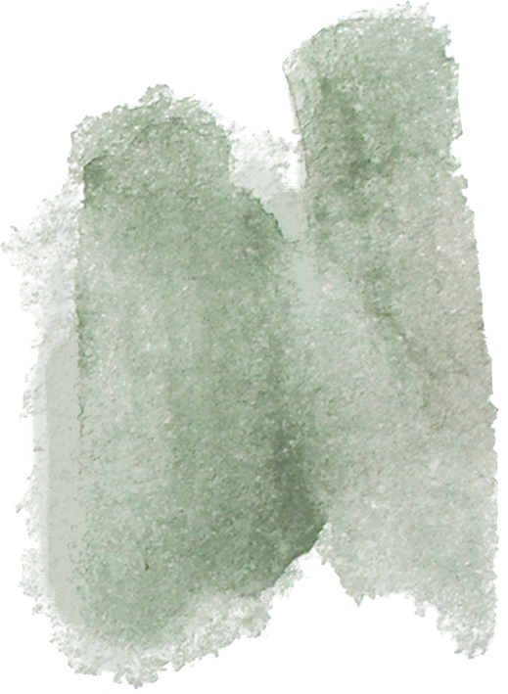
Research Paper Ideas
Improvements to models
Improvements to the dataset
Techniques used in data processing
Output:
A reliable model that can be used for deployment!

Slide 8
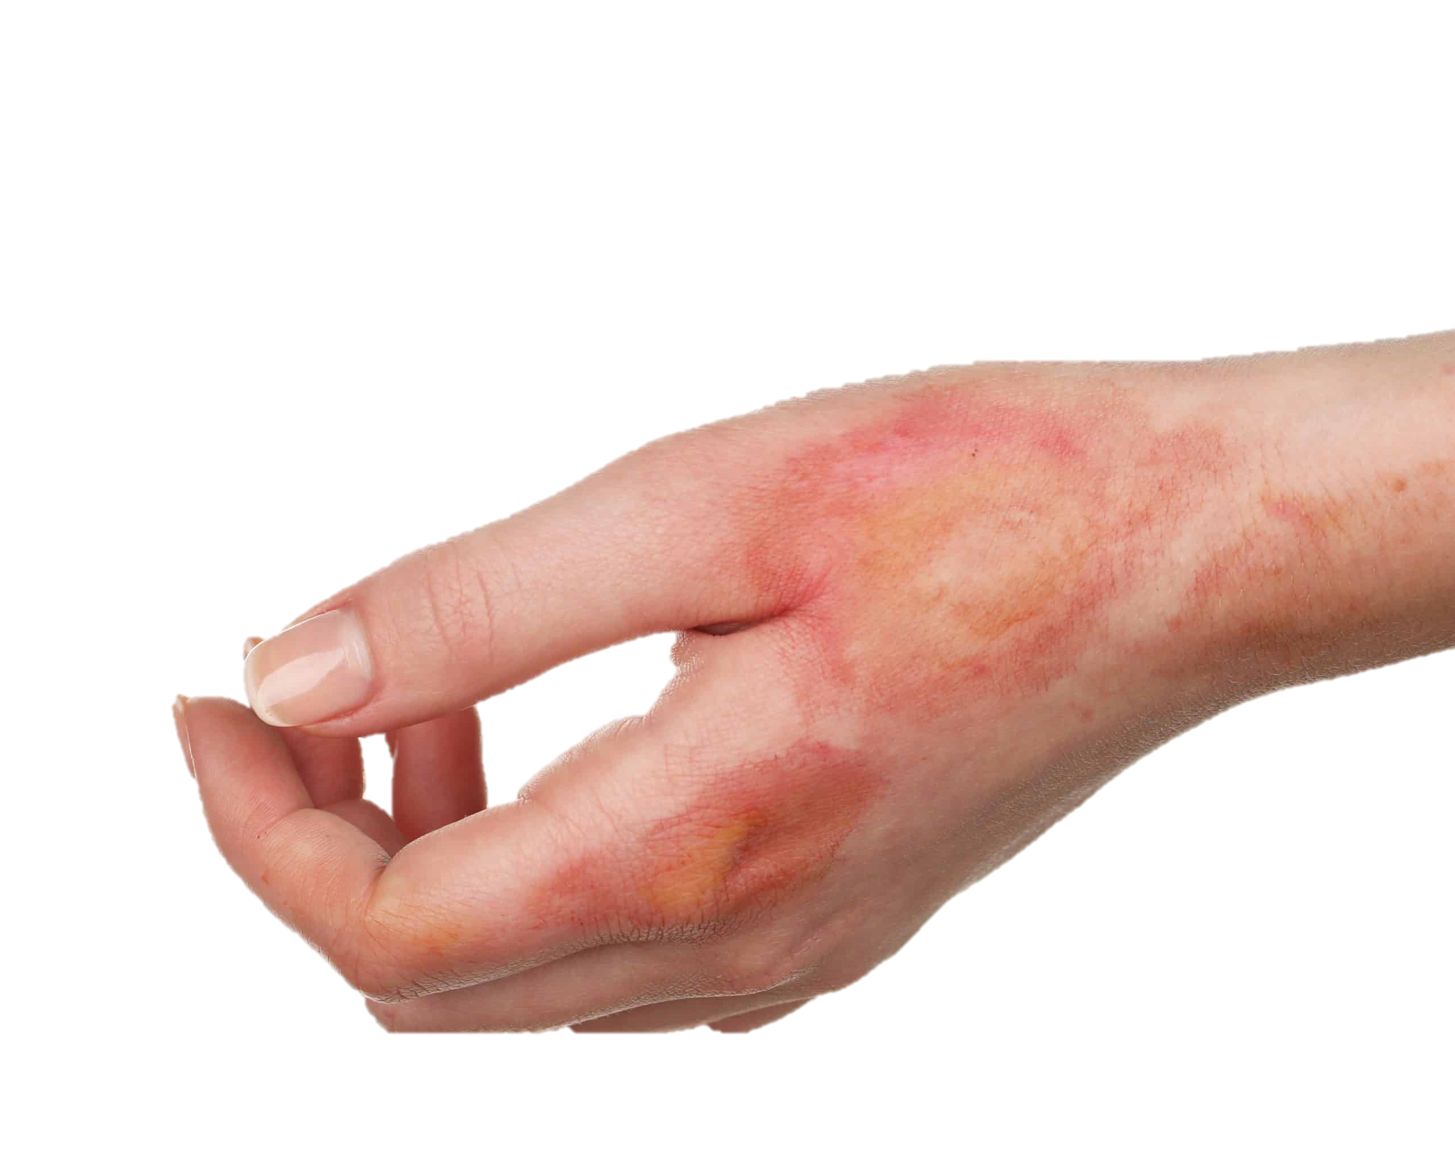
Degree 2: 92%
Degree 1: 86%
Degree 2: 96%

Slide 9
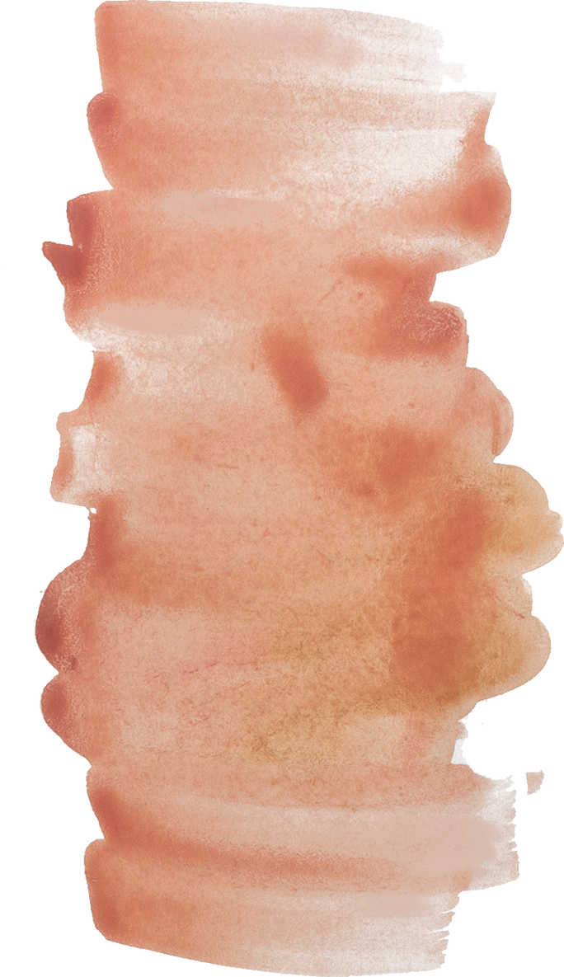
Related Work
Name of study #1
Name of Study #2
Name of Study #3
Presentations are communication tools that can be demonstrations, lectures, speeches, reports, and more.
Presentations are communication tools that can be demonstrations, lectures, speeches, reports, and more.
Presentations are communication tools that can be demonstrations, lectures, speeches, reports, and more.

Slide 10

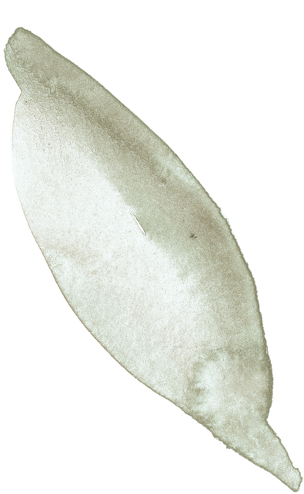
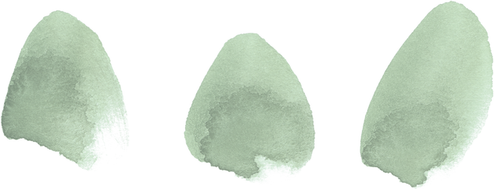
Future Scopes
Mobile Application
Web Interface
Develop a mobile application that can be used by medical practitioners to get instant results
A simple web interface where the user can upload the images of the burnt body parts, the platform would results from the model
AR Application
Business Application
A mobile application that uses camera and provide live results on the various degrees of burns and their location
Can be made proprietary and provide access to only hospitals/other medical institutes.

